Slide 1
Opening a Business in Toronto
By: Jerussha Jesuratnam

Slide 2

Introduction
Opening a business in Toronto can be overwhelming as there’s so much competition and you may not know where to start
This study will help us narrow down what the most popular businesses are and where exactly they’re located in Toronto

Slide 3
Data
In order to retrieve the most optimal solutions to this problem we will be using:
https://en.wikipedia.org/wiki/List_of_postal_codes_of_Canada:_M
http://cocl.us/Geospatial_data
https://api.foursquare.com

Slide 4
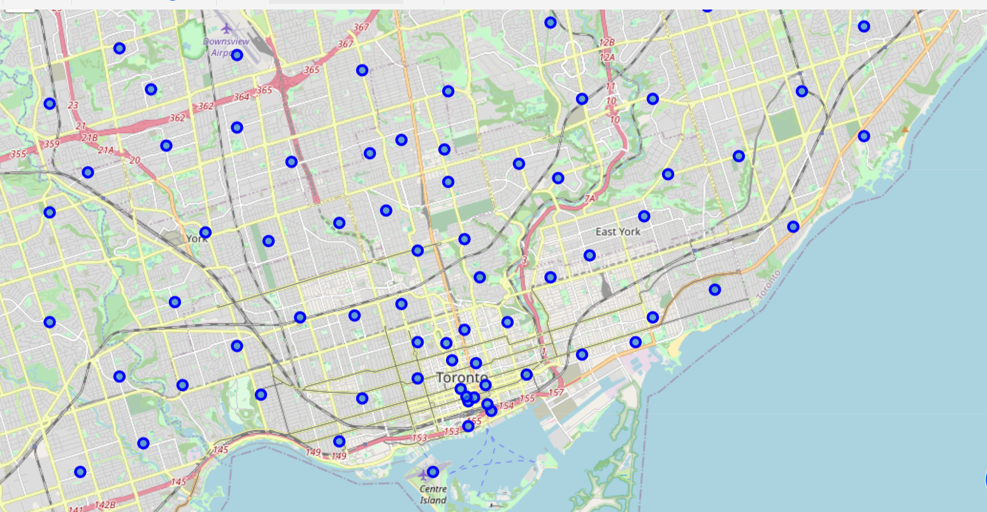
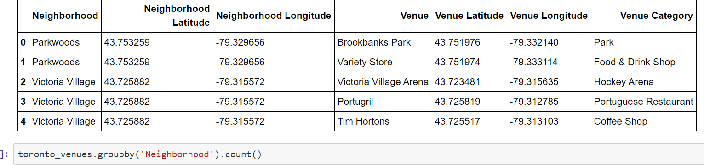
Data Analysis
Map of Toronto Neighborhoods
Merged table of toronto neighborhoods and venues using foursquare api

Slide 5
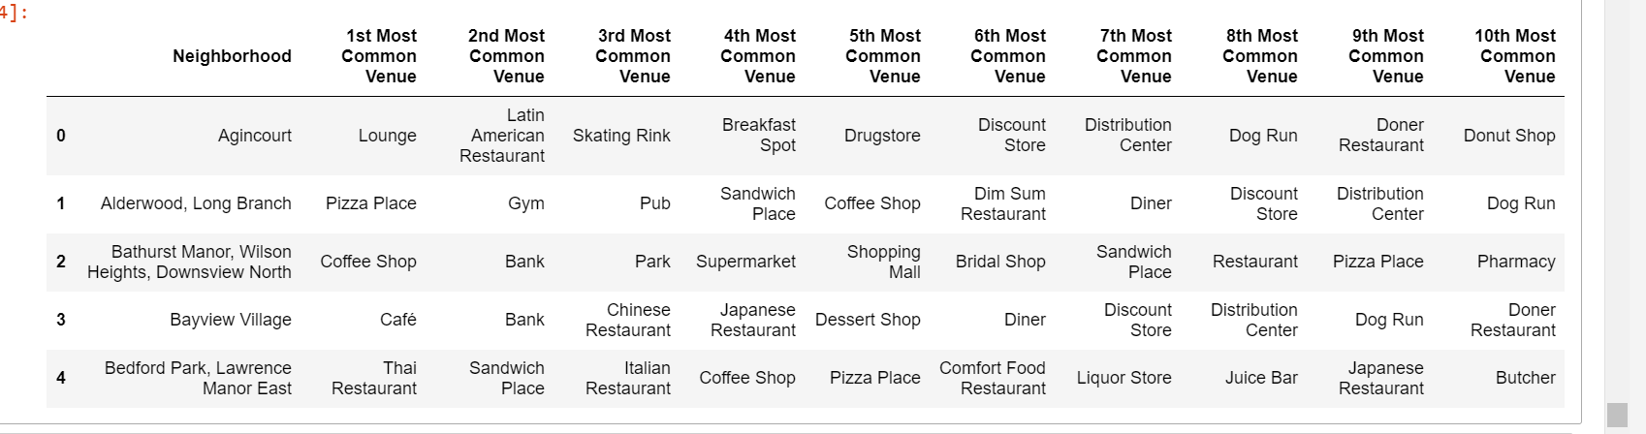
Toronto neighborhoods and most common venues

Slide 6
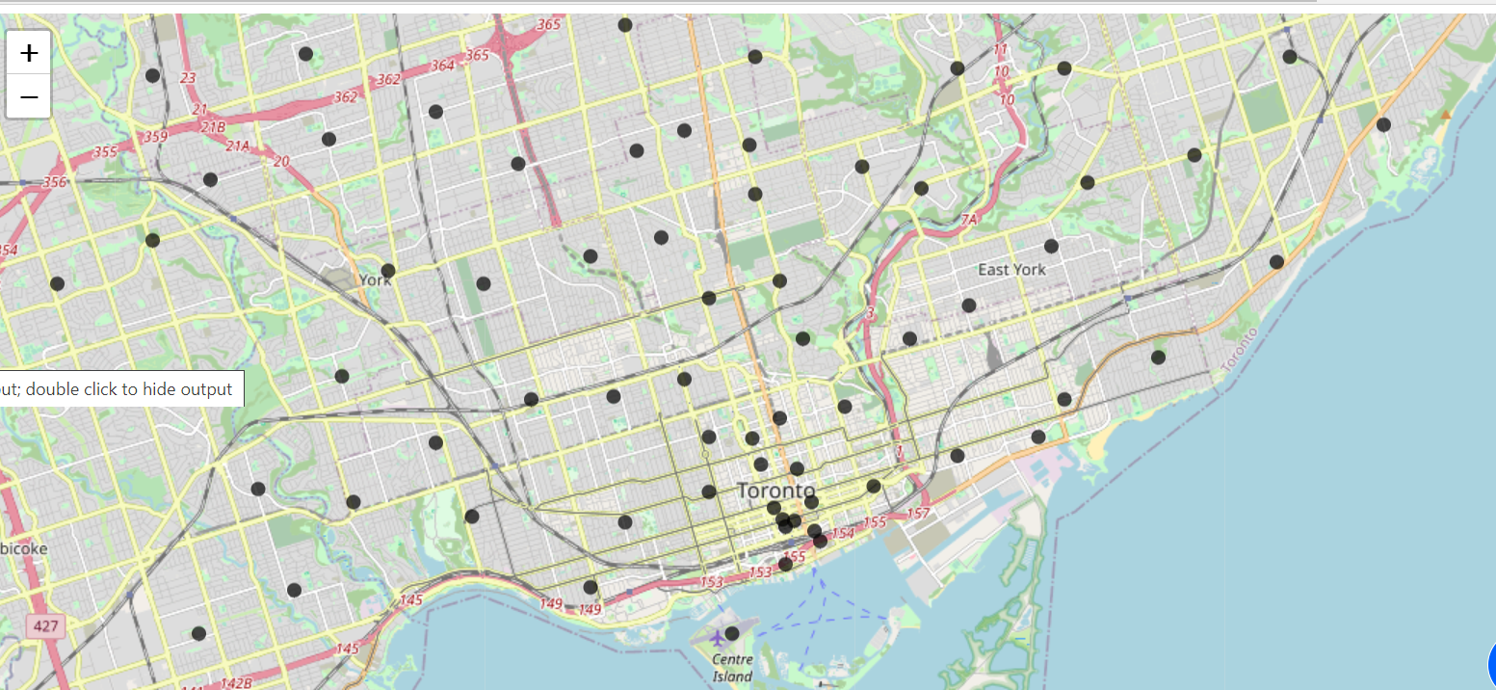
Map of clusters in Toronto neighborhoods of common venues

Slide 7
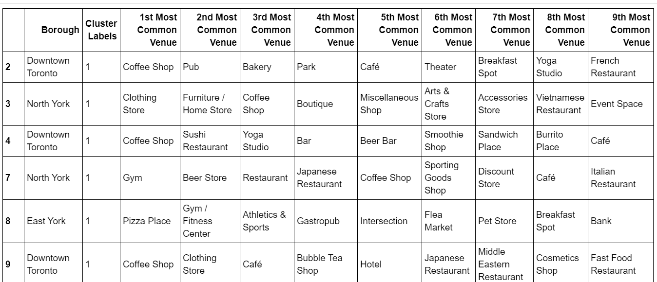
Results
Boroughs with custer 1 for common venues: which are coffee shops

Slide 8
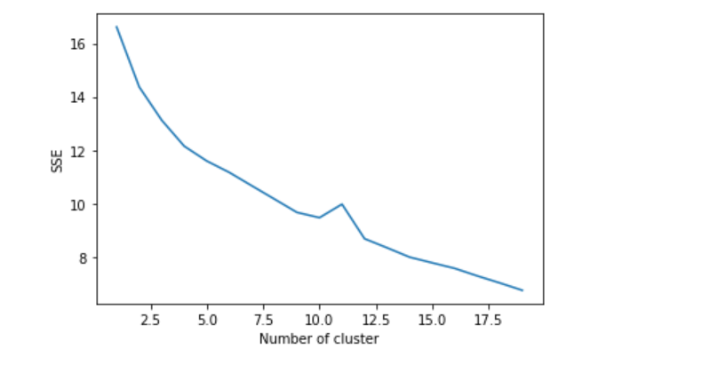
Results
The analysis shows that after the cluster analysis the most popular businesses opened in Toronto are, parks and coffee shops. The area in Toronto with most business seems to be Union with must clustering.
We can also see that every area near Toronto's most common venue in cluster 1 are parks.
Restaurants are another common venue as we can see in the table. Cafes especially are the most common food store.
Cluster analysis of venues in Toronto:
as you can see as the number of clusters
increases the sum of squares (SSE)
decreases which shows that as the number of
cluster increases the more similar the consumers
will be in the market.

Slide 9
Conclusion
In conclusion, this study was obtained to highlight areas in Toronto to open a business and the type of business that would be most successful to the population of Toronto. As we can see after cluster analysis is that the area in Toronto that has the most common venues are Downtown Toronto, near Union. This is due to the large population of people who are commuting to Toronto, the most business is seen in this area with venues like coffee shops, parks and cafes that seem to be the most desired at the times people arrive or depart from the train station.

